Slide 1



Deep Learning Design Patterns with Tensorflow 2.0
Computer Vision Workshop - Wide Models Version: Feb 2020
Repo: github.com/GoogleCloudPlatform/keras-idiomatic-programmer
twitter.com/andrewferlitsch

Slide 2
Wide Convolutional Neural Networks
Background
Up to now, we’ve focused on networks with deeper layers, block layers and shortcuts. Starting in 2014 with Inception v1 (GoogLeNet) and 2015 with ResNeXt (Microsoft Research) and Inception v2, neural network designs moved into wide layers (vs. deeper layers).
Essentially, a wide layer is having multiple convolutions in parallel and then concatenating their outputs.

Slide 3
Wide Convolutional Neural Networks
Inception V1 (GoogLeNet)
The GoogLeNet (Inception v1) won the 2014 ILSVRC contest for ImageNet and introduced the inception module.
The inception module is a convolutional layer with parallel convolutions of different sizes, with the outputs from each convolution are concatenated together.
The principle behind it was that instead of trying to pick the best filter size for a layer, each layer has multiple filter sizes in parallel, and the layer “learns which size is the best”.

Slide 4
Naive Inception Module
Input
The inception module is a convolutional block where the input to the block is passed through four branches: a pooling layer for dimensionality reduction, and a 1x1, 3x3 and 5x5 convolutional layer.
The outputs from the pooling and the other convolution layers are then concatenated together.
Pool
1 x 1
3 x 3
5 x 5
Concatenate
Output

Slide 5
Naive Inception Module
The author’s theory behind it, is that the different filter sizes would capture different levels of detail.
The 1x1 convolution captures fine details of features, while the 5x5 captures more abstract features.
# The inception branches (where x is the previous layer) x1 = layers.MaxPooling2D((3, 3), strides=(1,1), padding='same', activation='relu')(x) x2 = layers.Conv2D(64, (1, 1), strides=(1, 1), padding='same', activation='relu')(x) x3 = layers.Conv2D(96, (3, 3), strides=(1, 1), padding='same', activation='relu')(x) x4 = layers.Conv2D(48, (5, 5), strides=(1, 1), padding='same', activation='relu')(x) # concatenate the filters x = layers.Concatenate()([x1, x2, x3, x4])

Slide 6
Naive Inception Module
By setting padding=’same’, the height and width dimensions of the input are preserved. This allows concatenating the corresponding outputs from each branch together. For example, if the above the input to this layer was 28x28x256, the dimensions at the branch layers would be:
x1 (pool) : (?, 28, 28, 256)
x2 (1x1) : (?, 28, 28, 64)
x2 (3x3) : (?, 28, 28, 96)
x3 (5x5) : (?, 28, 28, 48)
After the concatenation, the output would be:
x (concat) : (?, 28, 28, 464)
A summary() for a naive inception module shows 544K parameters to train.

Slide 7
Inception V1
In the GoogLeNet, a further dimensionality reduction was introduced by adding a 1x1 bottleneck convolution to the pooling, 3x3 and 5x5 branches. This dimension reduction reduced the overall computational complexity by nearly ⅔.
What can a one pixel size filter being scanned across each channel learn any feature?
The use of 1x1 convolution acts like glue code. They are either used to
Expand or reduce the number of channels in the output while preserving the channel size (shape).
The former (expand) is referred to as a linear projection
The latter (reduce) is referred to as a bottleneck and is used to reduce the number of channels between the input to a block and the input to a convolutional layer.

Slide 8
Inception V1 Block
1x1 linear projection (expand) is analogous to “learning the optimal method to upsample”.
1x1 bottleneck (reduce) is analogous to “learning the optimal method to downsample”.
Input
Pool
1 x 1
1 x 1
1 x 1
1 x 1
3 x 3
5 x 5
Concatenate
Output

Slide 9
Inception V1 Block
Below is an example of an Inception v1 module:
# The inception branches (where x is the previous layer) x1 = layers.MaxPooling2D((3, 3), strides=(1,1), padding='same', activation='relu')(x) x1 = layers.Conv2D(64, (1, 1), strides=(1, 1), padding='same', activation='relu')(x1) x2 = layers.Conv2D(64, (1, 1), strides=(1, 1), padding='same', activation='relu')(x) x3 = layers.Conv2D(64, (1, 1), strides=(1, 1), padding='same', activation='relu')(x) x3 = layers.Conv2D(96, (3, 3), strides=(1, 1), padding='same', activation='relu')(x3) x4 = layers.Conv2D(64, (1, 1), strides=(1, 1), padding='same', activation='relu')(x) x4 = layers.Conv2D(48, (5, 5), strides=(1, 1), padding='same', activation='relu')(x4) # concatenate the filters x = layers.concatenate([x1, x2, x3, x4])
A summary() for these layers shows 198K parameters to train, in contrast to 544K parameters in the native inception module.

Slide 10
Inception V1 Architecture
GoogLeNet (Inception v1) architecture consists of four components:
Learner
Inception Group (3 Blocks)
Inception Group (1 Block)
Inception Group (2 Blocks)
Inception Group (1 Block)
Inception Group (2 Blocks)
Stem
Classifier
Stem Convolution
Group
Convolutions / Dense / Softmax
Convolutions / Dense / Softmax
Convolutions / Dense / Softmax
In paper, blocks are referred to
as inception modules.
Auxiliary Classifiers

Slide 11
Inception V1 Architecture
Auxiliary Classifiers
The GoogleLeNet architecture introduced the concept of an auxiliary classifier. The principle here is that as a neural network gets deeper in layers (i.e., the front layers get further away from the final classifier) the front layers are more exposed to a vanishing gradient and increased time (e.g., number of epochs) to train the weights in the front most layers.
Average
Pooling
(5x5)
Conv 1x1
(128 filters)
Flatten
Dense (1024)
Dropout
Dense
(N classes)
Input
Output
Reduces number of feature maps --feature pooling.
Reduces size of feature maps.

Slide 12
Inception V1 Architecture
Classifier
This is a single and final classifier in both training the neural network and in prediction.
Average
Pooling
(NxN)
Flatten
Dropout
Dense
(N classes)
Input
Output
Feature Maps are 7x7 for v1/v2 and 8x8 for v3 (bottleneck layer)
Reduces to 1x1 Feature Maps, where N is the input size

Slide 13
Inception V2
Factoring Convolutions
Inception v2 introduced the concept of factorization for the more expensive convolutions in an inception module to reduce computational complexity, and reduce information loss from representational bottlenecks.
The larger a filter (kernel) size is in a convolution, the more computationally expensive it is.
A 5 x 5 convolution in the inception module was 2.78x more computationally expensive than a 3 x 3. In the Inception v2 module, the 5 x 5 filter is replaced by a stack of two 3 x 3 filters, which results in a reduction of computational complexity of the replaced 5 x 5 filter by 33%.

Slide 14
Inception V2
Factoring Convolutions
Inception v2 introduced the concept of factorization for the more expensive convolutions in an inception module to reduce computational complexity, and reduce information loss from representational bottlenecks.
The larger a filter (kernel) size is in a convolution, the more computationally expensive it is.
A 5 x 5 convolution in the inception module was 2.78x more computationally expensive than a 3 x 3. In the Inception v2 module, the 5 x 5 filter is replaced by a stack of two 3 x 3 filters, which results in a reduction of computational complexity of the replaced 5 x 5 filter by 33%.

Slide 15
Inception V2 Block
Representational bottleneck loss occurs when there are large differences in filter sizes.
By replacing the 5 x 5 with two 3 x 3, all the non-bottleneck filters are now of the same size, and the overall accuracy of the Inception v2 architecture increased over Inception v1.
Input
Filter Reduction
Pool
1 x 1
1 x 1
1 x 1
In paper, this is done to reduce computational complexity on the 3x3 and the more expensive 5x5 filters.
1 x 1
3 x 3
5 x 5
3 x 3
Linear Projection
In paper, this inception module is referred to as the traditional inception module --but differs from V1 by using two (double) 3x3 convolution layers, instead of one.
Concatenate
Output

Slide 16
Inception V2 Block
Inception v2 additionally added using a post-activation batch normalization (Conv-BN-RE) for each convolutional layer.
# The inception branches (where x is the previous layer) x1 = layers.MaxPooling2D((3, 3), strides=(1,1), padding='same')(x) x1 = layers.Conv2D(64, (1, 1), strides=(1, 1), padding='same')(x1) x1 = layers.BatchNormalization()(x1) x1 = layers.ReLU()(x1) x2 = layers.Conv2D(64, (1, 1), strides=(1, 1), padding='same')(x) x2 = layers.BatchNormalization()(x2) x2 = layers.ReLU()(x2) # REMOVED for brevity # concatenate the filters x = layers.concatenate([x1, x2, x3, x4])
A summary() for these layers shows 169K parameters to train, when compared to 198K for the inception v1 module.

Slide 17
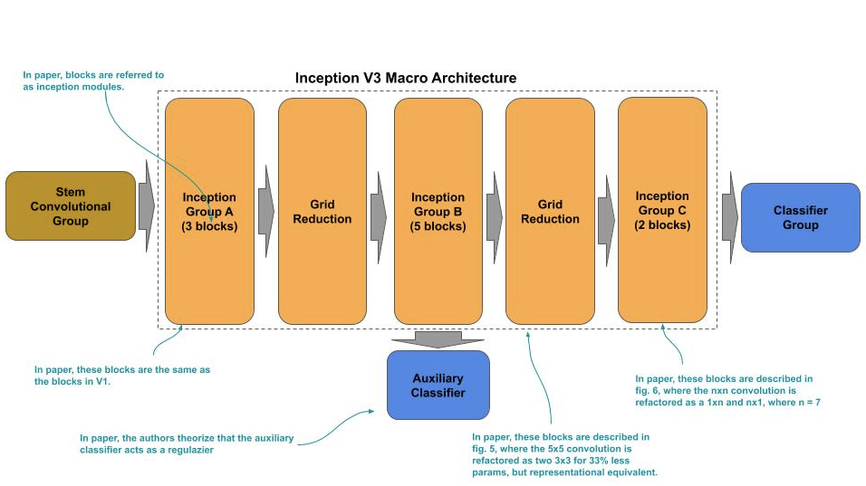
Inception V3
The Inception v3 introduced a new design to the macro architecture, as well as redesigning the stem group and reducing to using a single auxiliary classifier.

Slide 18
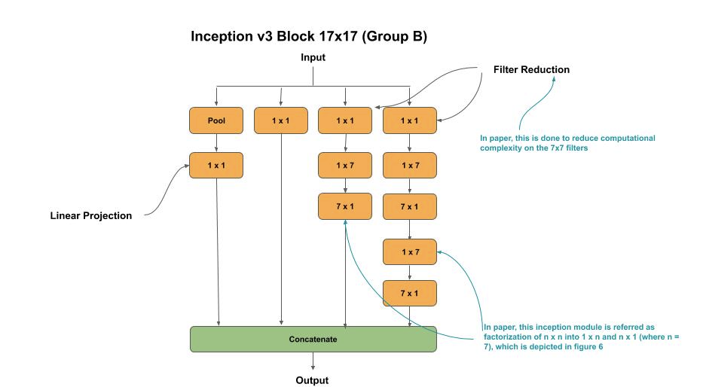
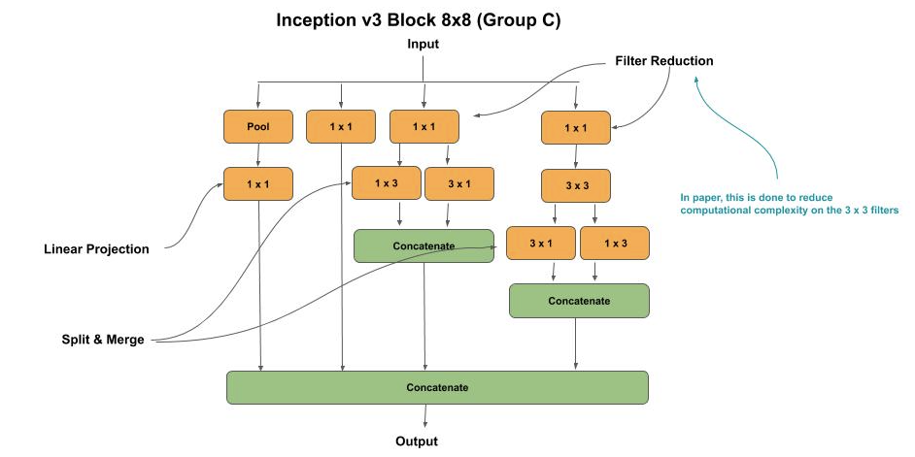
Inception V3 Blocks
The inception blocks in group A are the same as in inception v1 and v2, while group B and C are different. The output feature maps sizes for group A, B and C are 35x35, 17x17 and 8x8 respectively.

Slide 19
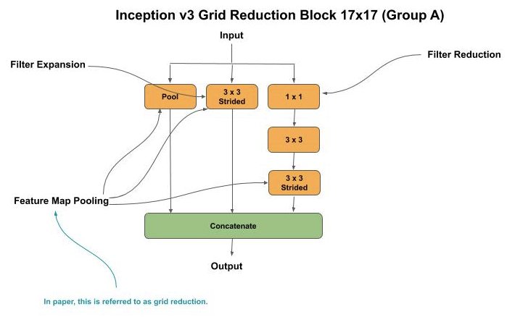
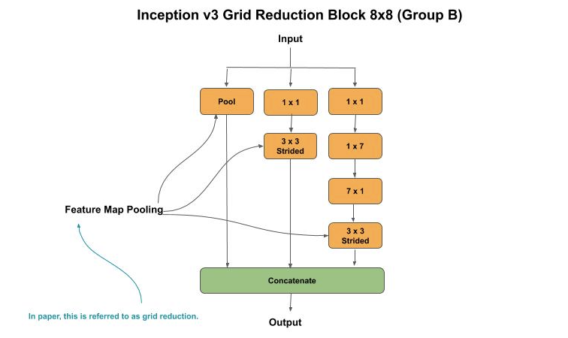
Inception V3 Blocks
The grid reduction blocks reduce the number of feature maps (channels) from the output of the previous group to match the input of the next group. Thus, grid reduction block A reduces from 35cx35 to 17x17, and grid reduction block B reduces from 17x17 to 8x8.

Slide 20
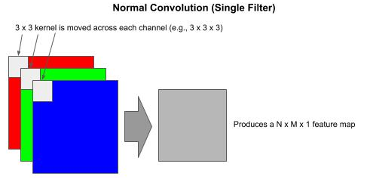
Inception - Normal Convolution
Normal Convolution
The kernel (e.g., 3 x 3) is applied across the height (H), width (W) and depth (D, channels). Each time the kernel is moved, the number of multiply operations equals the number of pixels as H x W x D.
On an RGB image (3 channels) with a 3 x 3 kernel done across all 3 channels, one has 3 x 3 x 3 = 27 multiply operations, producing a N x M x 1 (e.g., 8 x 8 x 1) feature map (per kernel), where N and M are the resulting height and width of the feature map.

Slide 21
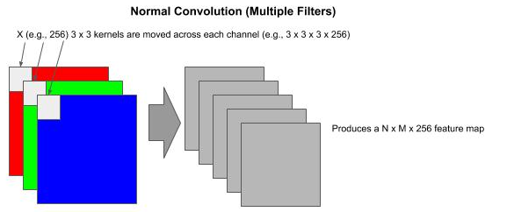
Inception - Normal Convolution
Normal Convolution
If we specify 256 filters for the output of the convolution, we have 256 kernels to train. In the RGB example using 256 3x3 kernels, we have 6,912 multiply operations each time the kernels move.

Slide 22
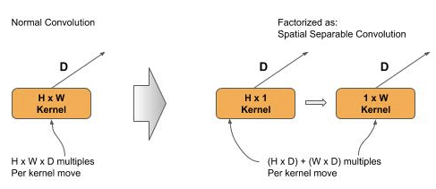
Inception - Spatial Separable Convolution
Spatial Separable Convolution
A spatial separable convolution factors a 2D kernel (e.g., 3x3) into two smaller 1D kernels. Representing the 2D kernel as H x W, then the factored two smaller 1D kernels would be H x 1 and 1 x W.
This factorization does not always maintain representational equivalence. When it does, it lowers the total number of computations by 1/3.
In the RGB example with a 3 x 3 kernel, a normal convolution would be 3 x 3 x 3 (channels) = 27 multiply operations each time the kernel is moved.
In the same RGB example with a factored 3 x 3 kernel, a spatial separable convolution would be (3 x 1 x 3) + (1 x 3 x 3) = 18 multiply operations each time the kernel is moved.
In the RGB example using 256 3x3 kernels, we have 4,608 multiples each time the kernels move.

Slide 23
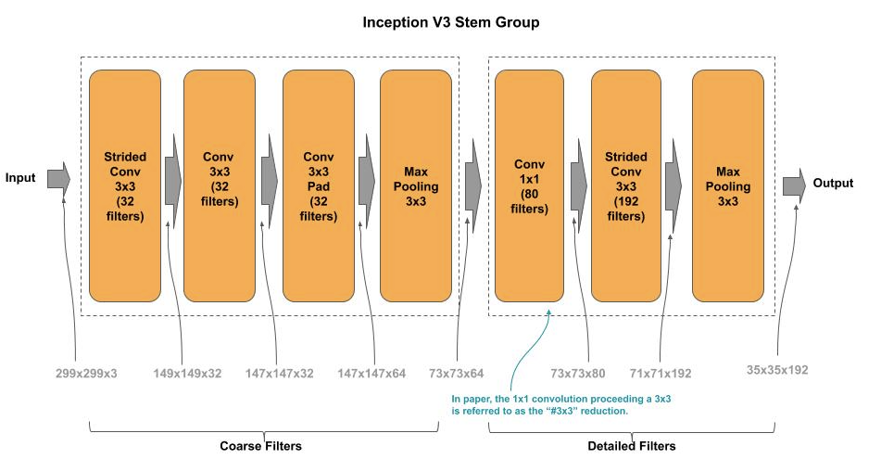
Inception V3 - Stem
Stem
The 7 x 7 convolution in the stem convolution group was factorized and replaced by a stack of three 3 x 3 convolutions, where:
The first 3 x 3 is a strided convolution (strides=2, 2) which performs a feature map reduction.
The second 3 x 3 is a regular convolution.
The third 3 x 3 doubles the number of filters.

Slide 24
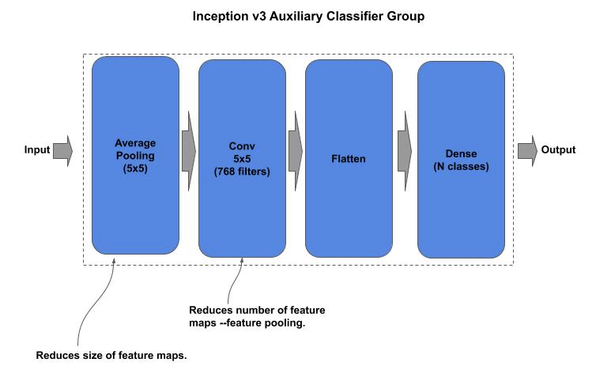
Inception V3 - Auxiliary Classifier
The auxiliary classifier was further simplified to:

Slide 25
ResNeXt
ResNeXt (Microsoft Research) was the winner of the 2015 ILSVRC competition for ImageNet and introduced the concept of a wide residual (block) neural network and cardinality (i.e., width).
This architecture uses a split, branch and merge method of parallel convolutional blocks. The number of parallel convolutional blocks (i.e., width) is referred to as the cardinality.

Slide 26
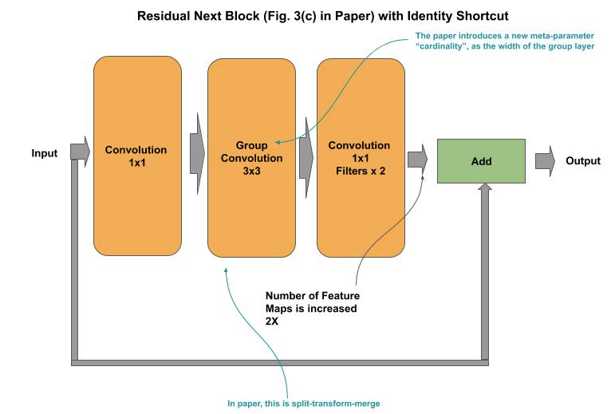
ResNeXt - Wide Residual Block
The wide residual block group consists of:
A first bottleneck convolution ( 1 x 1 kernel ).
A split-branch-concatenate convolution of cardinality N (Group Convolution).
A final bottleneck convolution ( 1 x 1 kernel ).
An identity link (shortcut) between the input and the final convolution output.
At each ResNeXt layer, the input from the previous layer is split across the parallel convolutional blocks, and the output (feature maps) from each convolutional block is concatenated, and finally the input to the layer is matrix added to the concatenated output (identity link) to form the residual block.

Slide 27
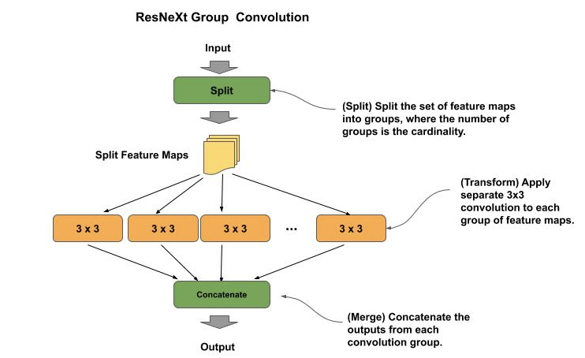
ResNeXt - Split-Transform-Merge
The first bottleneck convolution performs dimensionality reduction by reducing (compressing) the number of input feature maps, similar to its use in a residual block or inception module.
After the bottleneck convolution, the feature maps are split among the parallel convolutions according to the cardinality.
For example, if the number of input feature maps (channels) is 128 and the cardinality is 32, then each parallel convolution will get 4 feature maps (128 / 32).
The outputs from the parallel convolutions are then concatenated back into a full set of feature maps, which are then passed through a final bottleneck convolution for another dimensionality reduction.
As in the residual block, there is an identity link between the input to and output from the resnext block, which is then matrix added.

Slide 28
ResNeXt - Split-Transform-Merge
# Remember the input shortcut = x # Dimensionality Reduction x = Conv2D(filters_in, (1, 1), strides=(1, 1), padding='same')(shortcut) x = BatchNormalization()(x) x = ReLU()(x) # Cardinality (Wide) Layer (split-transform) filters_card = filters_in // cardinality groups = [] for i in range(cardinality): group = Lambda(lambda z: z[:, :, :, i * filters_card:i * filters_card + filters_card])(x) groups.append(Conv2D(filters_card, (3, 3), strides=(1, 1), padding='same')(group))
# Concatenate the outputs of the cardinality layer together # (merge) x = Concatenate()(groups) x = BatchNormalization()(x) x = ReLU()(x) # Dimensionality restoration x = Conv2D(filters_out, (1, 1), strides=(1, 1), padding='same')(x) x = BatchNormalization()(x) # Identity Link: Add the shortcut (input) to the output of the block x = Add()([shortcut, x]) x = ReLU()(x) return x

Slide 29
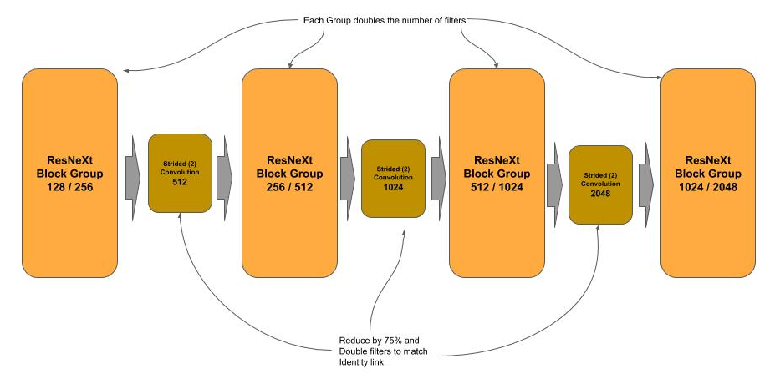
ResNeXt - Learner
Following the stem (7x7, max pooling) are four groups of resnext blocks. Each group progressively doubles the number of filters outputted vs. the input. Between each block is a strided convolution, which serves two purposes:
It reduces the data by 75% (feature pooling)
It doubles the filters from the output of the previous layer, so when the identity link is made between the input of this layer and its output, the number of filters match for the matrix addition operation.

Slide 30
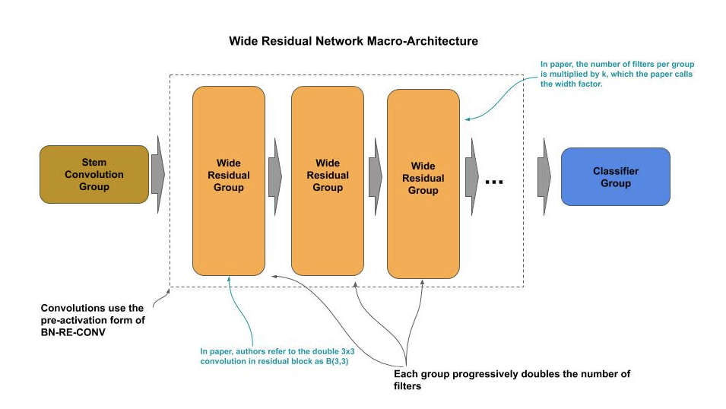
Wide Residual Network (WRN)
The Wide Residual Network (WRN) introduced in 2016 (Paris Tech University) took another approach to wide convolutional neural networks.
The authors’ theory was that as one goes deeper in layers, feature reuse is diminished and it takes longer to train. They did a study using residual networks and added a parameter for a multiplier on the number of filters (width) per residual block and decreasing the depth. They reported in their ablation study that a WRN with just 16 layers could outperform other state-of-the-art (WRN) architectures.

Slide 31
Wide Residual Network (WRN)
Their model used the following design considerations:
Pre-activation batch normalization (BN-RE-Conv) for faster training, as in the ResNet V2.
Use two 3x3 convolutionals (B(3, 3)) as in ResNet34 instead of the bottleneck residual block (B(1,3,1)) in ResNet50. The authors stated that the bottleneck design was not needed due to it was used to think deep networks to reduce parameters from being computationally expensive as the network goes deeper.
Denote “l” as the number of convolutional layers per group and “k” as the width factor to multiply the number of filters.
Moved using Dropout from the top layers (convention) to in-between each convolutional layer in the residual blocks and after the ReLU. The later the authors stated was to perturb the batch normalization.

Slide 32
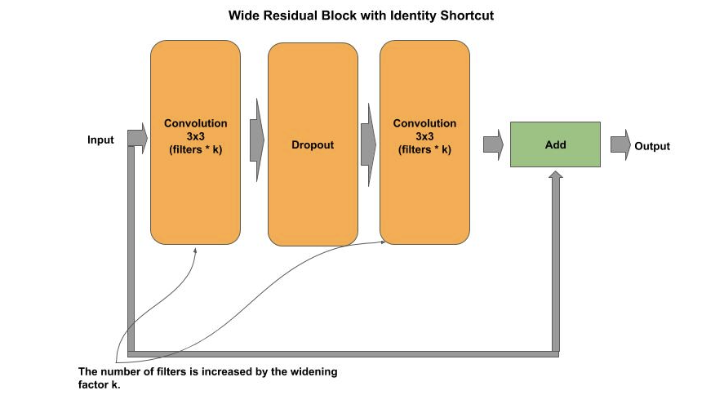
Wide Residual Network (WRN)
# Remember the input shortcut = x # First 3x3 convolutional layer x = Conv2D(filters_out, (3, 3), strides=(1, 1), padding='same')(x) x = BatchNormalization()(x) x = ReLU()(x) # Second 3x3 convolutional layer x = ReLU()(x) # Dropout after the ReLU to perturb the batch # normalization x = Dropout(rate)(x) x = BatchNormalization()(x) x = Conv2D(filters_out, (3, 3), strides=(1, 1), padding='same')(x) # Identity Link: Add the shortcut (input) to the output of # the block x = Add()([shortcut, x]) return x

Slide 33
Wide Residual Networks - Lab Exercise #6
Optional Code Lab - Get Familiar with Wide Residual Networks
Deep Learning Design Patterns - Workshop - Chapter 2.ipynb

